Slide 1


Airplane Crash Analysis
Group #1
Taha Mahmoud & Ashwinee Mehta

Slide 2
Agenda
Introduction
Related Work
Data
Methods
Story-telling
Results
Discussion and Future Work
Q & A

Slide 3
Introduction
Air Travel- The most common transport medium these days
During air travel, there are different factors that can cause the airplane to crash
Airplane Crash Analysis is performed for the two main reasons-
To determine the root cause of error by analyzing the trends in the historic data
To prevent an accident from happening in the future by making the required developments
What are the reasons behind the airplane crashes?

Slide 4
Related Work
planecrashinfo.com
Original source for airplane crash database
Analysis done
Number of fatalities over time
Fatalities by phase of flight
Causes of fatal accident by decade
Kaggle- Airplane Crashes [Data Visualization]
Analysis done
Count of accidents by year
Military Vs Passenger flights
Fatalities VS Ratio by year

Slide 5
Data
Data scraping
www.planecrashinfo.com
The code for scraping the data is taken from Github
Data cleaning
Insertion, deletion and datatype conversion
Data formatting
R Automation to classify data based on-
Frequent aircraft type
Flight stage
Reason for crash

Slide 6
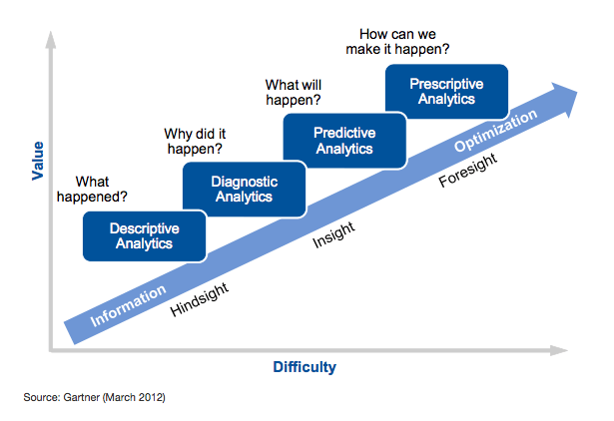
Methods

Slide 7
Story-telling
All visualizations are static
Out of 12 visualizations, 11 are produced using R and 1 using python

Slide 8
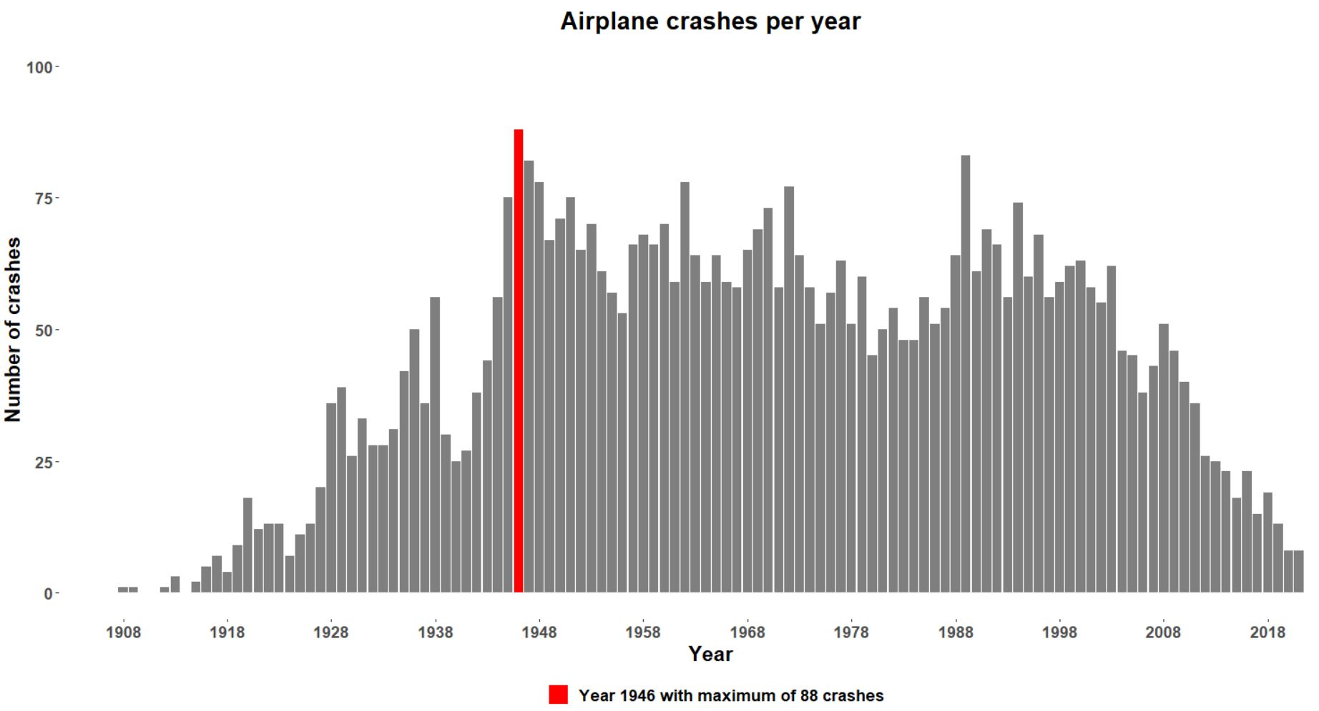

Slide 9
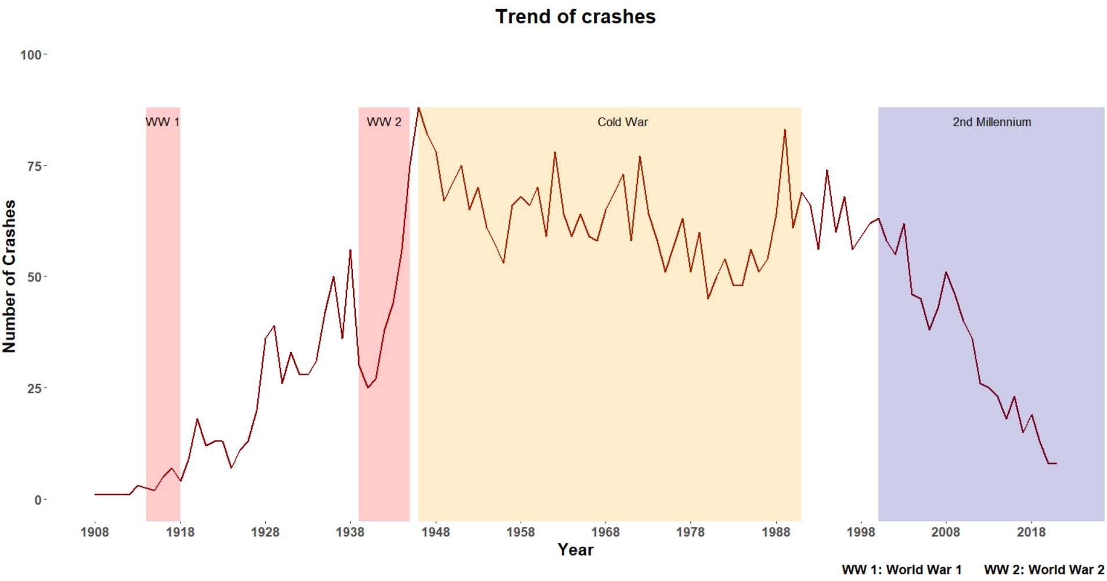

Slide 10
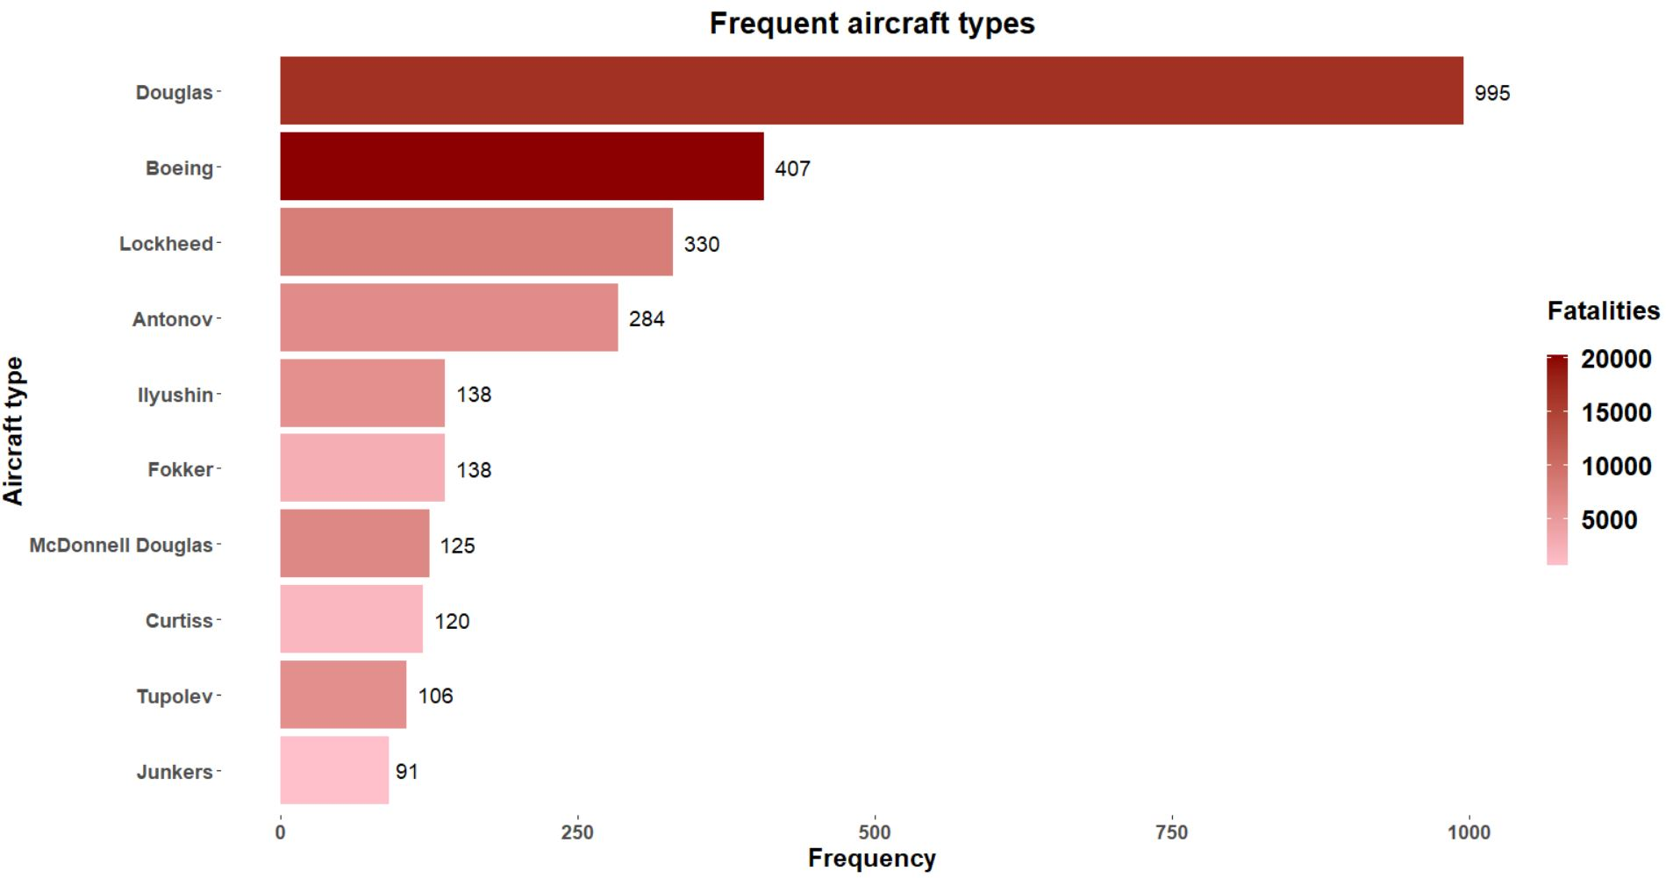

Slide 11
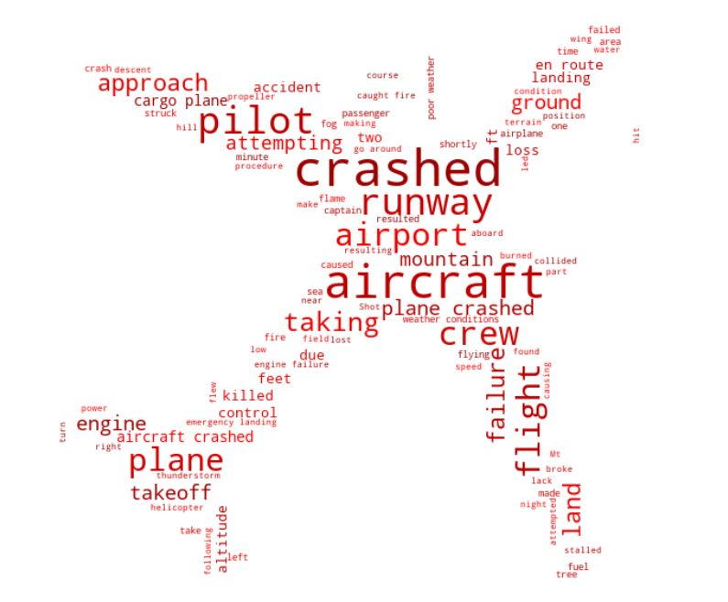
Word Cloud for Crash Summary

Slide 12
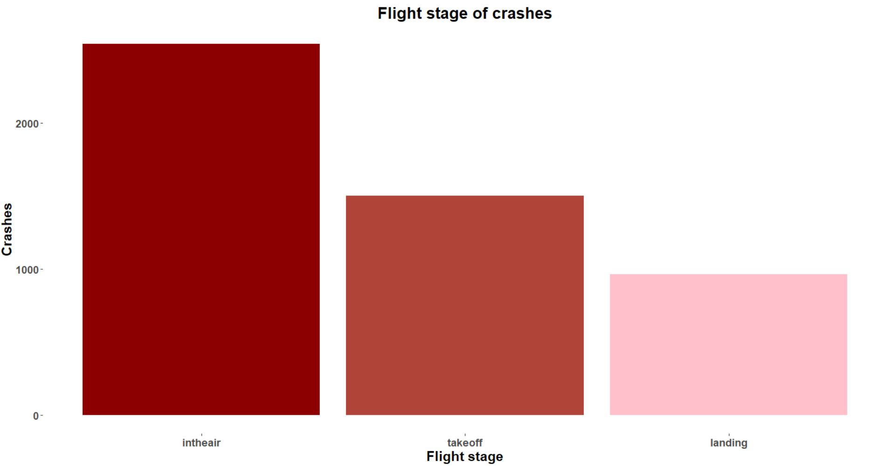

Slide 13
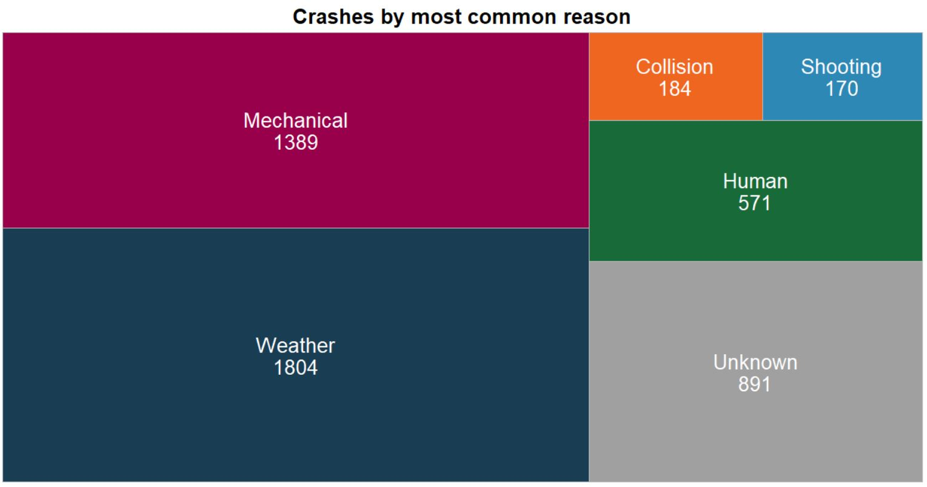

Slide 14
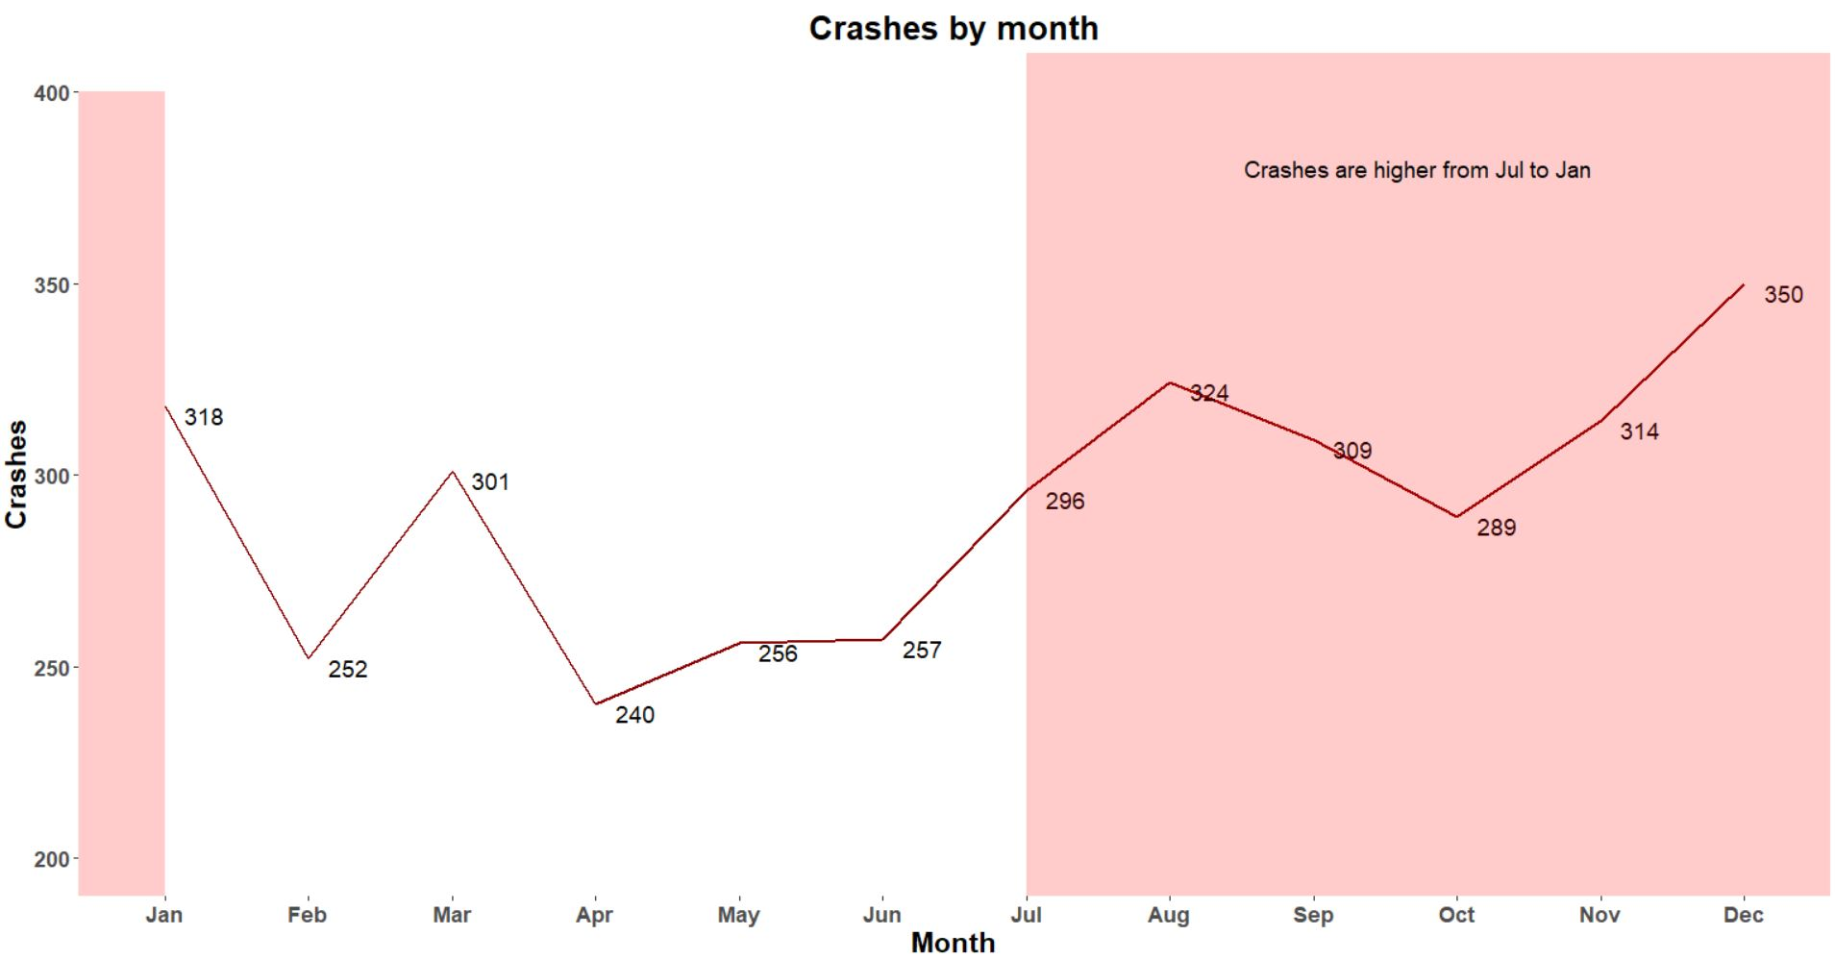

Slide 15
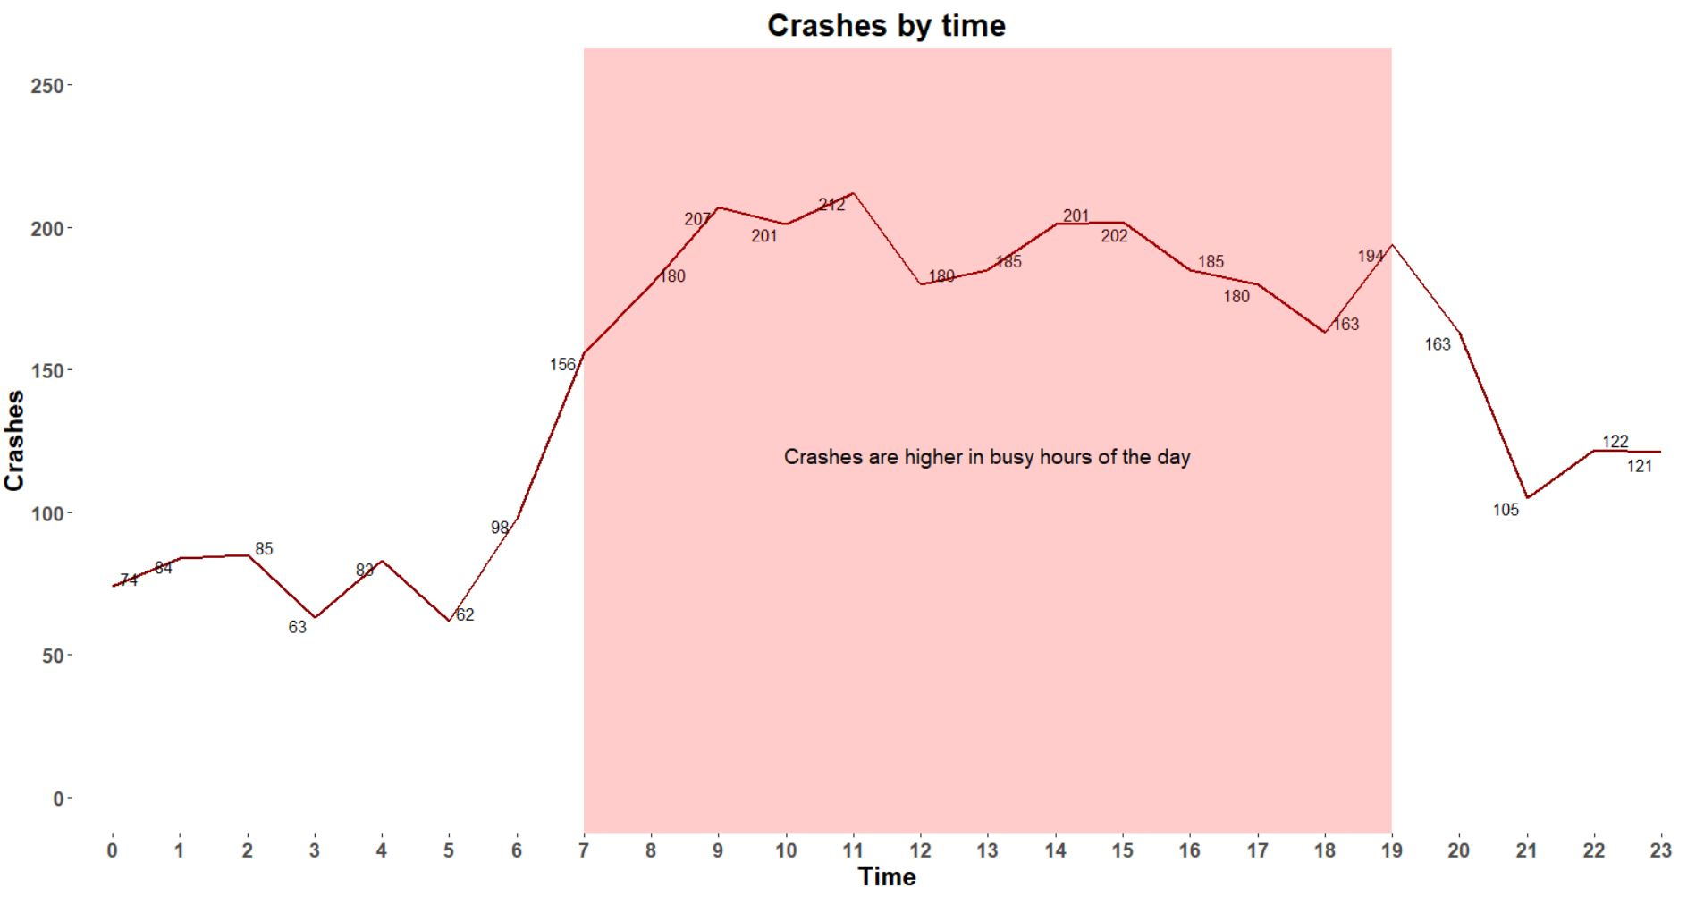

Slide 16
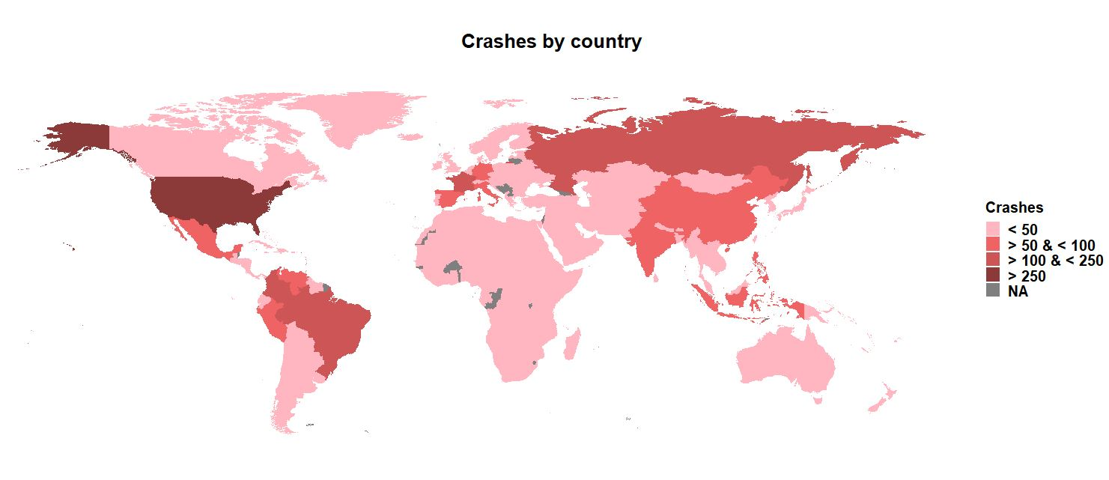

Slide 17
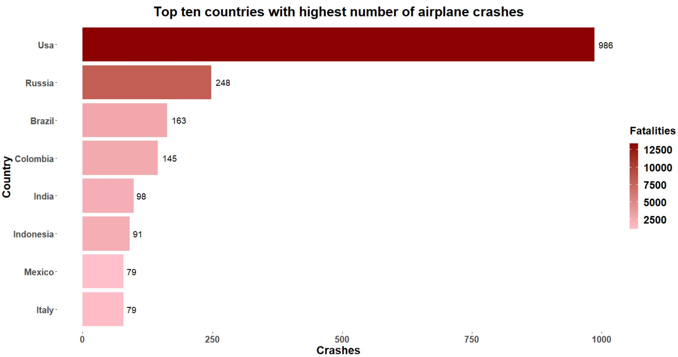

Slide 18
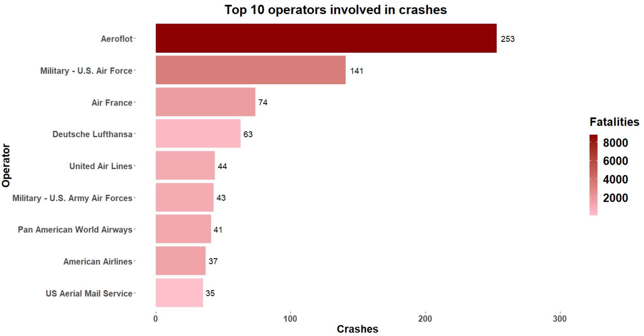

Slide 19
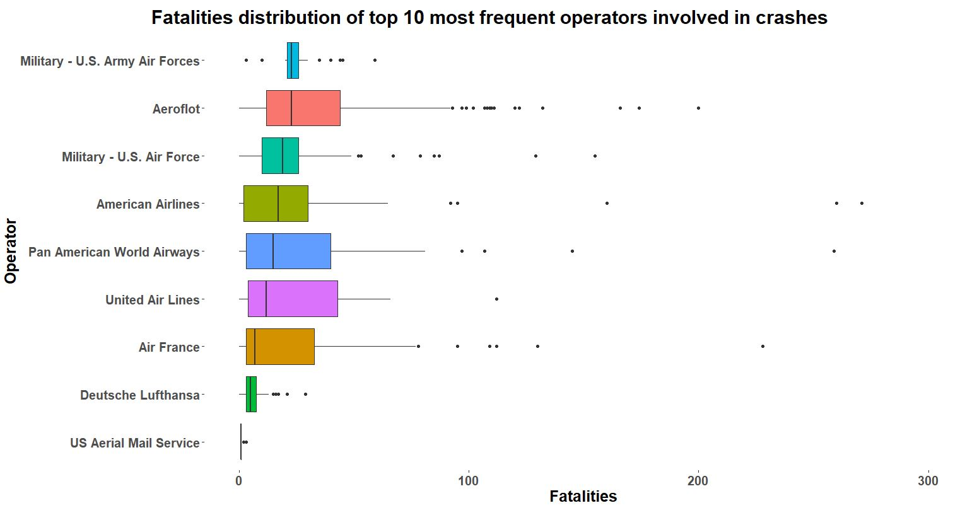

Slide 20
Results
From the crash trend, we can see an increasing trend during the World War 2 and the peak was observed in 1946
Despite air travel becoming very common lately, in the past 2 decades, we can see a decreasing trend in the number of crashes
Majority of the air crashes take place while aircraft is in the air and are commonly caused due to weather and mechanical reasons
Crashes are more common during the busy hours of the day and during the winter months of the year
United States and Russia are the countries with the highest number of crashes.
Aeroflot and Military U.S. Air Force are the most frequent operators with highest number of crashes and fatalities

Slide 21
Discussion and Future Work
The current scope of the project is limited to the airplane crash dataset
The scope can be extended to include additional datasets that contain flight statistics like total number of flights/passengers departing, arriving, etc. and weather data
Route analysis to determine if the crashes were common for long/short distances
Dig deep to find a more specific reason for airplane crashes

Slide 22
Q & A

Slide 23
Thank You!

